Slide 1
Basic presentation

Slide 2
Agenda
Hypothesis and Initial thoughts
Overview of Data
City by Sales Amount
City by Sales Amount pt. 2
Cuisine Insights
Cuisine Insights pt. 2
Sales and Order Seasonality
Sales/Order Insights
Final Takeaways and Last Comments
Thank You
Appendix

Slide 3
Hypothesis & Initial Thoughts
What we Believe at First Glance
See higher trends in Italian and American Cuisine
Maybe see Pizza being highest
Seasonality to sales
Amount of sales by geography will be close in total number
What analysis will show.
Sales data analysis to support where next location should be
A clear picture of open date window and cuisine to focus on.

Slide 4
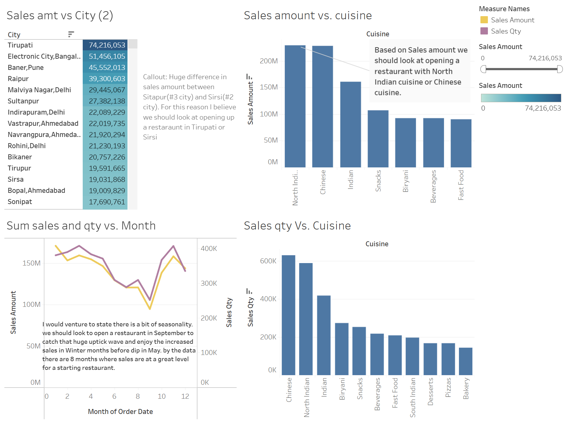
Overview of Data

Slide 5
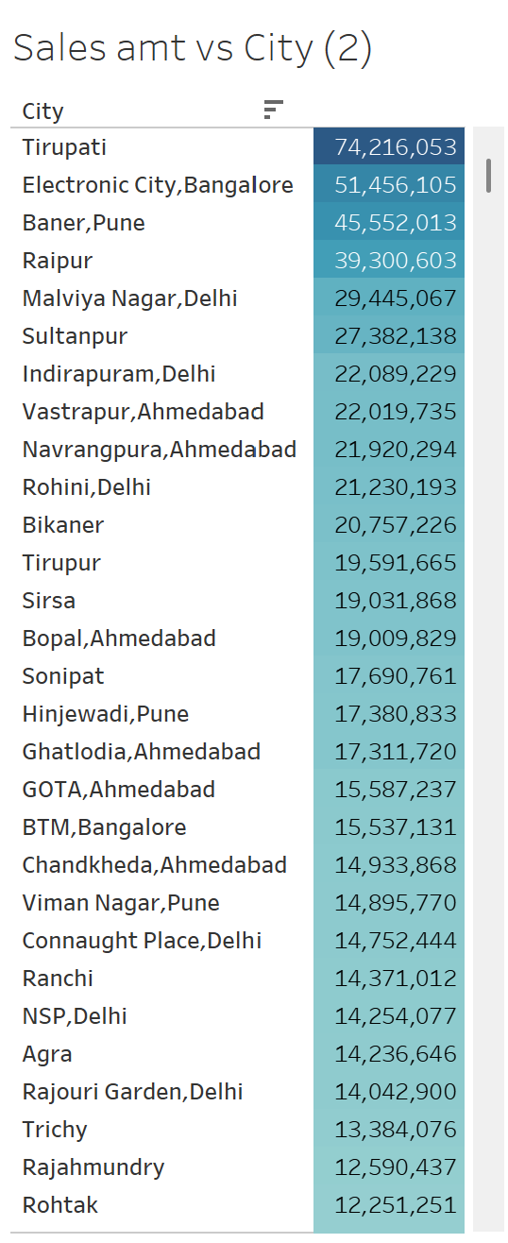
City by Sales amount
Table shows total sales amount by city.
Sales amount is sales $
Anything above 30mil is significant.
Top 3 cities are seeing significant sales totals
Callout: Tirupati has a significantly higher total sales amount then next closest city

Slide 6
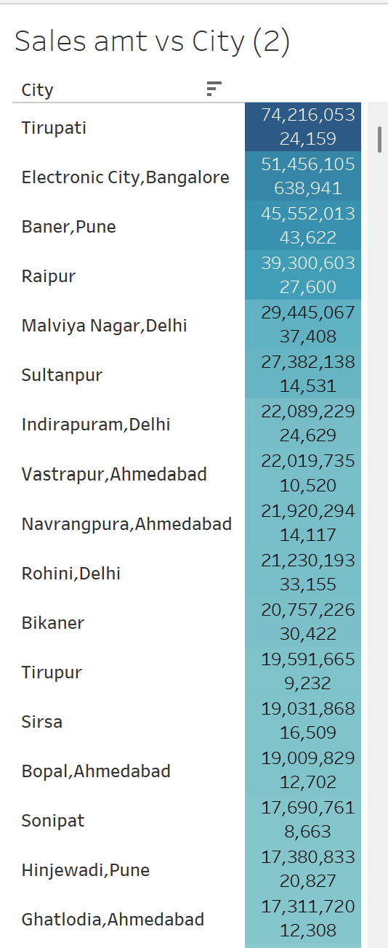
City by Sales amount
Table shows number underneath as sales qty by city.
Sales qty is #of orders
We can see the correlation between sales quantity and sales amount (i.e. how many sales does it take to earn that amount of sales dollars)
Callout: for Tirupti, total of 24,159 total sales with total sales dollars of 74mil. Less total sales more total money.
Callout: Electronic City, which is 23mil less in total sales dollars had 638k total number of sales. A lot of orders for similar but less capital gain.
Recommendation: Future location should be located in Tirupati

Slide 7
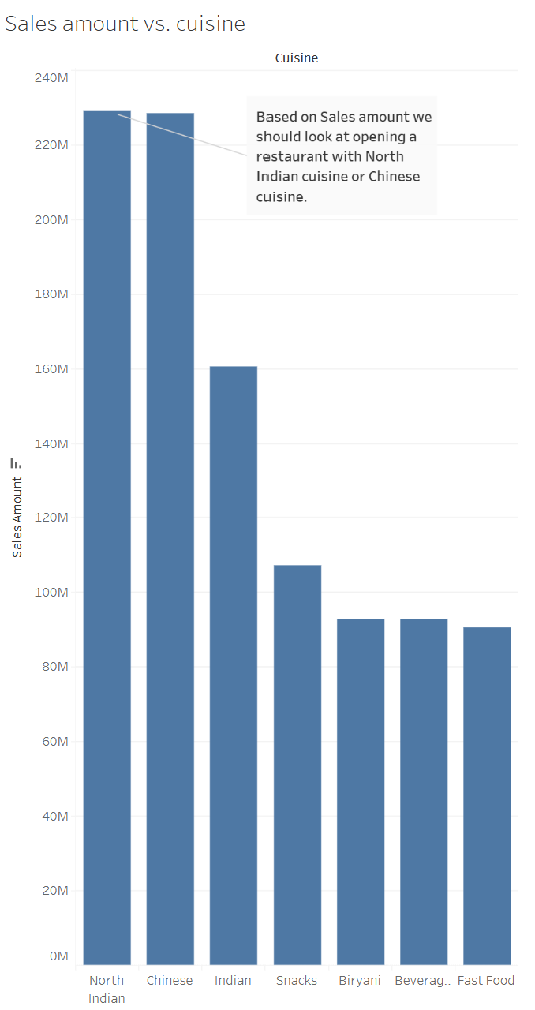
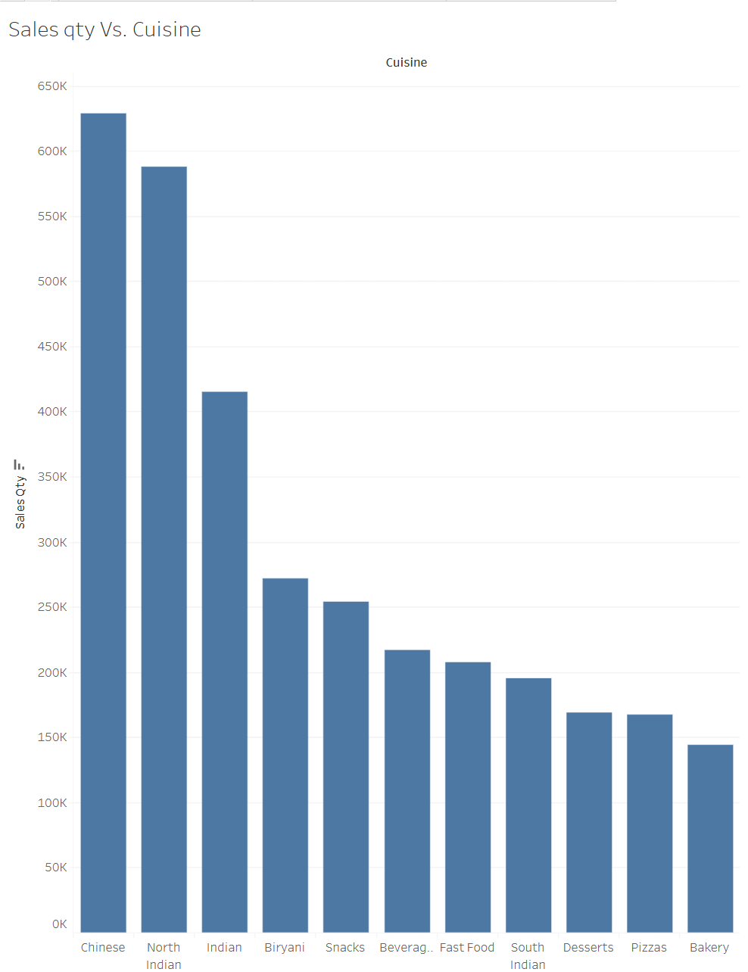
Cuisine insights

Slide 8
Cuisine insights
Previous slide shows to bar charts for cuisine broken down by sales mount and sales quantity.
Huge difference between top two cuisines and the field.
Chinese and North Indian cuisine are top for both sales amount and sales quantity
Recommendations: Future restaurant cuisine should be one of these.

Slide 9
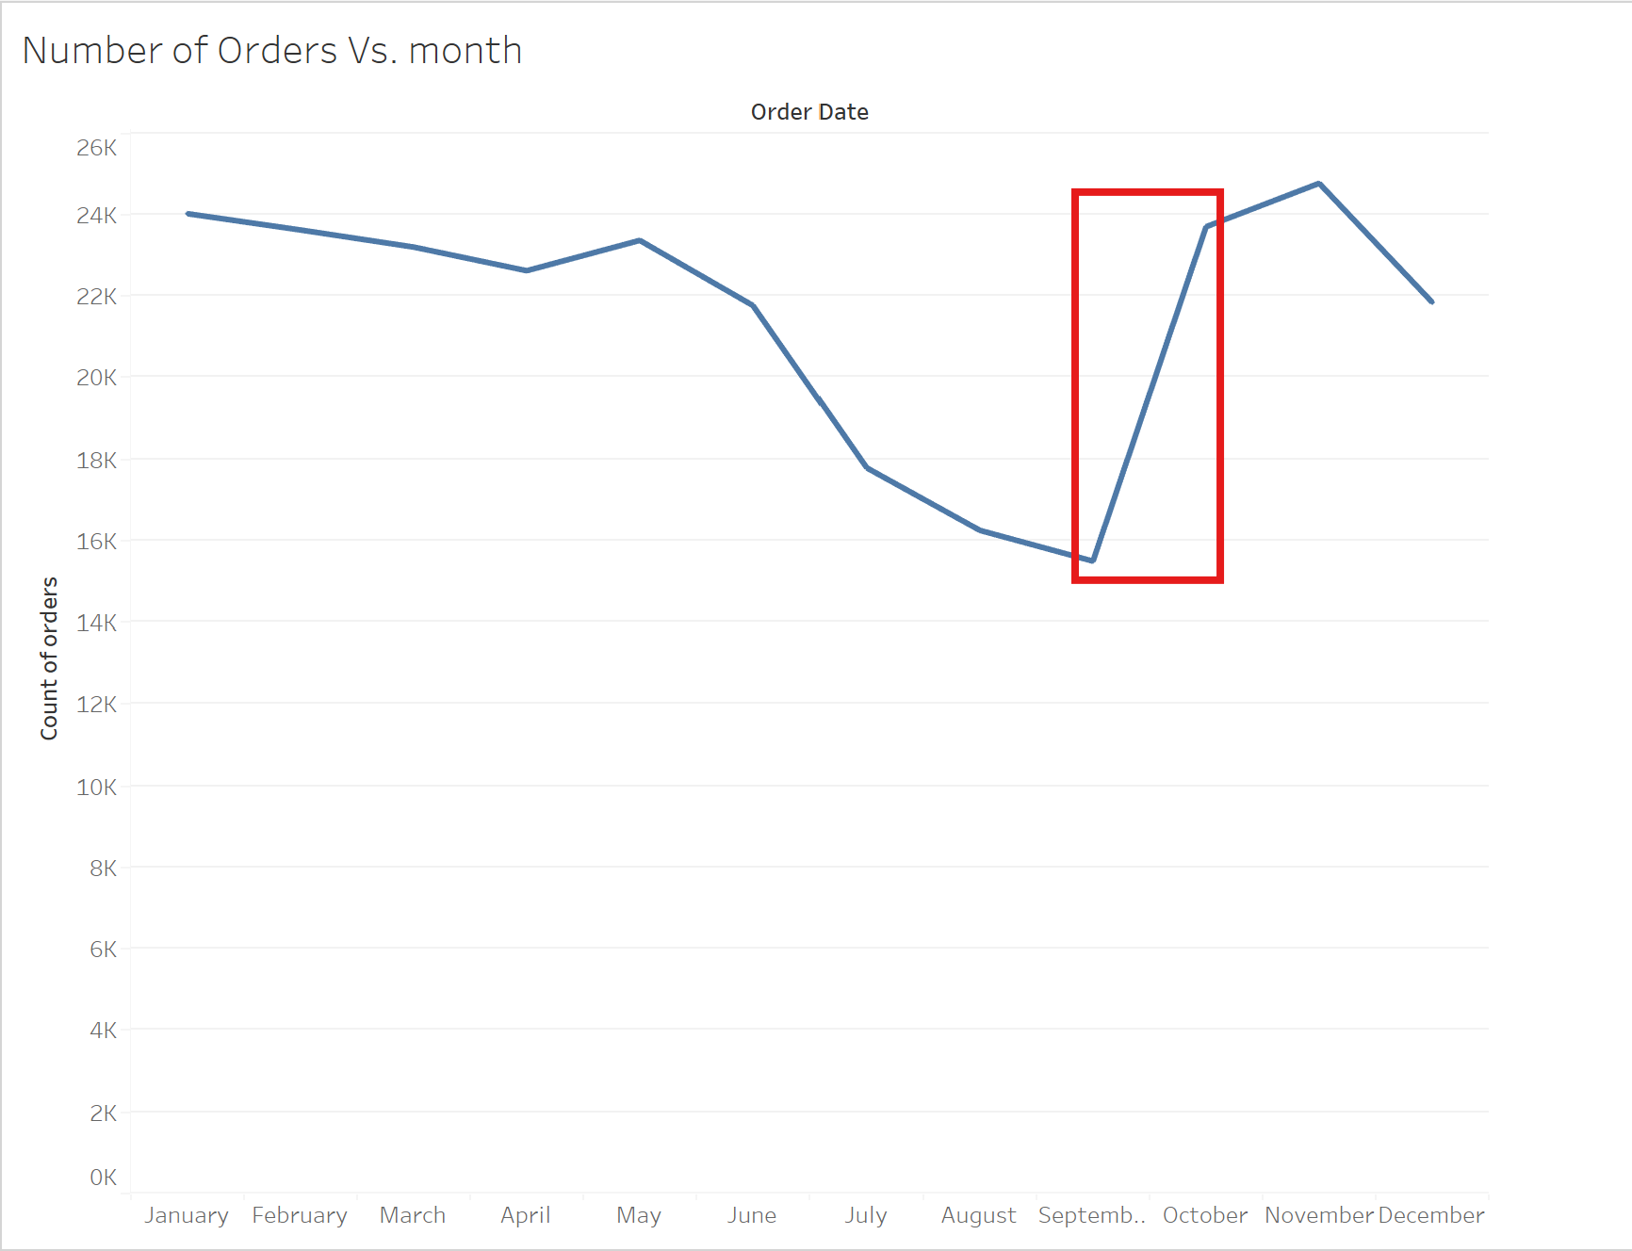
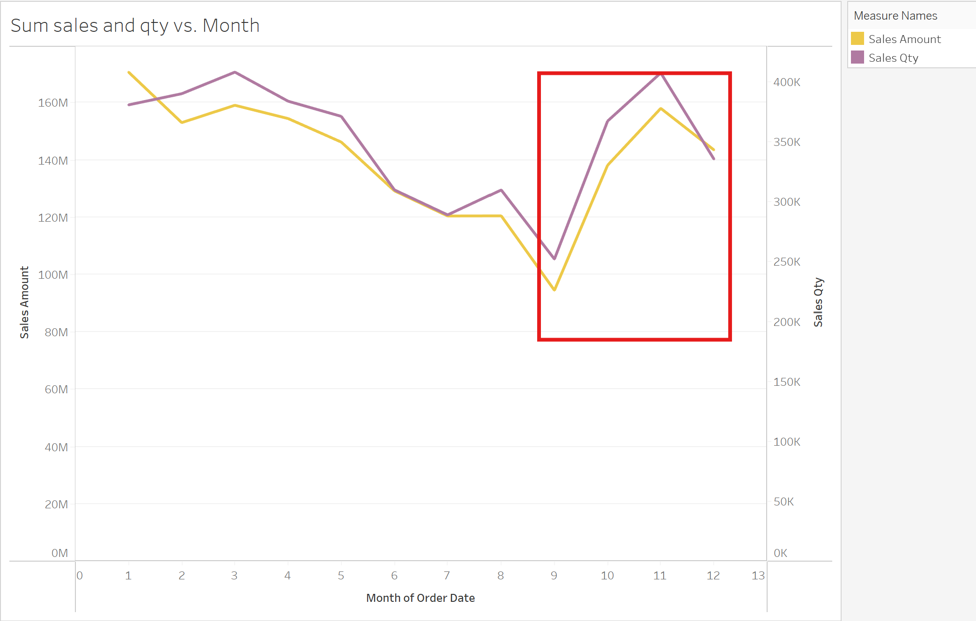
Sales and Order Seasonality

Slide 10
Sales/Order Insights
As you can see in both orders by month and sales qty & sales amt, there is clear seasonality.
There is a palpable dip in the summer months with peak lows in September.
Huge spike to peak conditions October to November leading to a slow decrease through May.
Summer is low Season, Fall and Winter being High season
Callout: if opening in September for a launch into October we will see almost 8 months of optimal sales
Recommendation: when opening new location, need to consider a Go Live date somewhere in October to take advantage of seasonality.

Slide 11
Final Takeaways & last Comments
Further analysis may be needed, but we uncovered a great deal of information regarding sales analysis, where to open new location, and what potential sales look like.
Potential city for new location: Tirupati
Potential Cuisines: North Indian Cuisine or Chinese Cuisine
Peak Months: October and November
Peak Seasons: Fall and Winter Months
Low Season: Summer
Lastly, all information looks very promising and to see full data set please see appendix and tableau workbook.

Slide 12
Thank you
Carl Lane
Data Analyst
clane@companyemail.com
www.companyname.com
I Look forward to further analysis!

Slide 13
Appendix
Tableau Public Workbook - https://public.tableau.com/views/FinalProject-SalesAnalysis/ZomatoNewLocationSalesAnalysis?:language=en-US&publish=yes&:sid=&:redirect=auth&:display_count=n&:origin=viz_share_link

